Slide 1
Forestview Technologies Final Project: Arcade Simulator
Talha Ali, Mohammad Hoque, Soham Bhavsar, Maher Harkati, Amran Rahim

Slide 2
Introduction
Usability
Interface
Project Details

Slide 3
Project Overview
Front End:
Back End:
Multiple Games
Visuals
Homepage
Projects
Functionality
Responsive
Tracking Users

Slide 4

Tech Stack
Version Control & Collaboration:
GitHub Desktop
Visual Studio Code IDE
Front End:
Back End:
Python
Tkinter
Pygame
HTML, CSS, and JavaScript

Slide 5
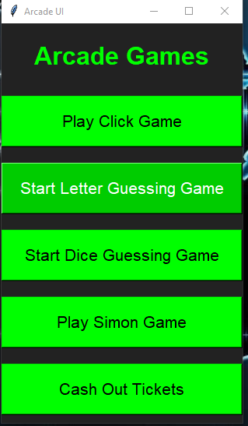
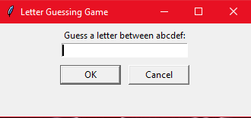
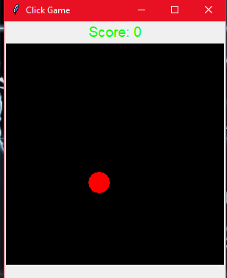
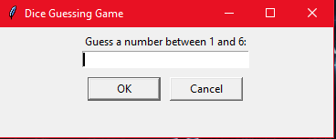
Project Demo

Slide 6
Challenges Along The Way
Back End: Tracking users through the different games
Front End: Adding pages for users to acknowledge

Slide 7

Conclusion
Efficiency
Clarity
Teamwork
Success
Notes:
In conclusion, Forestview Technologies has successfully developed an engaging arcade-style video game platform, driven by our commitment to efficiency and innovation. Our methodical approach, collaborative teamwork, and utilization of advanced tools have resulted in a platform that not only meets but exceeds the project's requirements.
The concerted efforts of each team member have been instrumental in bringing our vision to life. From crafting seamless gameplay experiences to designing intuitive user interfaces, our team has worked tirelessly to ensure every aspect of the platform is finely tuned and user-friendly.
Looking ahead, we are eager to further enhance our platform's capabilities. We aim to prioritize scalability to accommodate future growth, enhance security measures to safeguard user data, and refine the user interface for an even more immersive experience. By incorporating these improvements, we are poised to deliver a platform that sets new standards in the gaming industry.
In summary, Forestview Technologies is proud to offer a comprehensive arcade platform that combines entertainment, innovation, and technical excellence. Thank you for considering us for this project, and we look forward to the opportunity to bring our platform to life for your audience.

